Slide 1
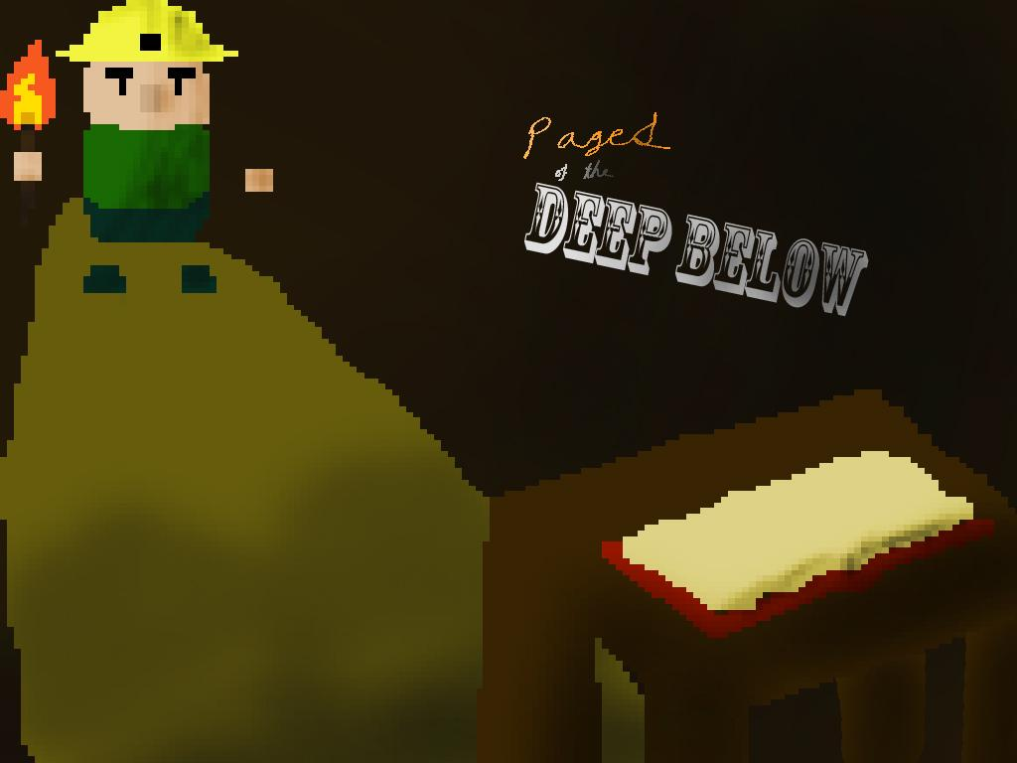
Title Pages of the Deep Below Visual, Audio, and Programming Joshua Oliveros, 10th Grade, iTech Academy,
Miami Springs Senior High School Integrated Development Environment Yoyo Games, GameMaker, GML Language Game Platform Windows Game Genres Educational, Platformer Target Audience E for Everyone, ages 7+ (Young Literate Children and above)

Slide 2
What I Learned
I learned the large transitions in the methods of mining over time
I learned that during Ancient Egyptian times, Pharaohs and their royal family favored a green wispy ore called Malachite when it came to jewelry (such as necklaces) and decorations (such as pots and urns).
I learned that a vast majority of Ancient Egyptians were slaves.
I learned that a commonly used mining method called fire-setting was used by the slaves to mine easier. The method consisted of placing a fire beneath an outcropping or wall to heat it up and make it easier to break. Sometimes they would douse it with a liquid to break it up a little, utilizing thermal shock, but this method was often only used to get closer without getting burned.
I learned that booby traps were real, and can be found in ancient structures (such as tombs) today.
I learned that the Industrial Revolution brought a whole new change to the world of mining by the newfound usage of explosives. More specifically, dynamite.
I learned that due to the massive need for labor in the new mining and factory industries, child labor became very prominent, especially in the mining industry. The small bodies of children were often used to get where full grown men couldn’t.
I learned mines were extremely dangerous places to be. Mines never discriminated when it came to taking lives. The lives of children and adults alike were lost to cave-ins, gas explosions, and gas poisoning.

Slide 3
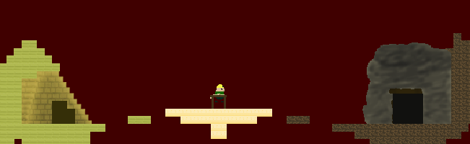
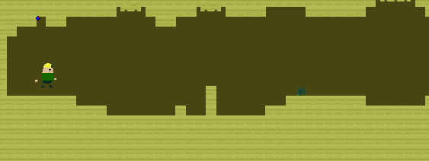
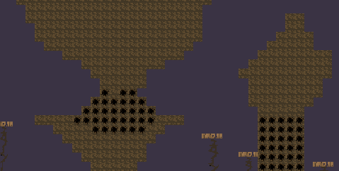
Visual Theme
Art and animation in 8-bit and 16-bit alike.
A void-like level selection room.
An Ancient Egyptian tomb/excavation site (in Ancient Egypt).
A caved-in mine during the Industrial revolution.

Slide 4



Concept and Game Mechanics
A miner finds himself in a strange void-like place where a magic book tells him to uncover the history of mining.
The player is expected to choose one of two entrances on either side of him, each leading to another level where they are told the objective.
In one level, the player has the ability to lay down fire. This is needed to get past brightly colored sandstone blocks that obstruct the player
In another, the player has the ability to lay down dynamite. This will be needed to get past rubble indicated by a black spot. To lessen the hassle and time needed to complete the level, the player will not be damaged by the explosions.

Slide 5


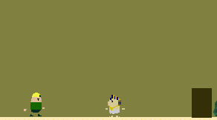
Hub/Tutorial
Levels
In the Hub (level selection room) players are told their quest and the base controls. To both sides of the player, are the entrances to the tutorial levels. The Hub appears to be a void-like area between worlds.
In the Industrial revolution tutorial area (to the right), you are confronted by a child miner who asks you for help in rescuing his little brother and hints at the times they’re in.
In the Ancient Egyptian tutorial area (to the left), you are commanded by a pharaoh to retrieve five malachite chunks, addressing you as a slave and speaking of the traps that lie ahead.

Slide 6
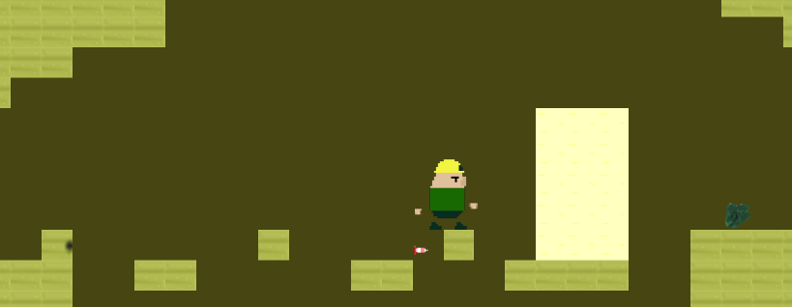
Levels:
Ancient Egypt
In this level, the player is trying to reach the end of the level alive and collect all five Chunks of malachite.
The level is laden with dart traps and pitfalls, with a single surprise enemy at the end, as warned of by the pharaoh.
The level also has spires of sandstone, in which the player has to place down a fire to crack and break through.
The player can only take three hits in this level until they run out of health and are forced to restart.

Slide 7
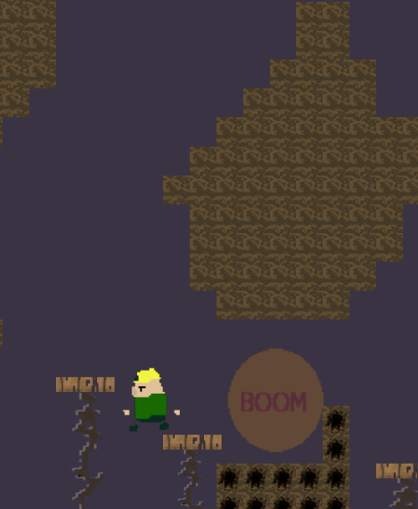
Levels:
Industrial Revolution
In this level, the goal is to reach the end and talk to the child without falling out of the level.
This level revolves around placing dynamite to get past the destructible rubble blocking your way.
There are no traps in this level, and only the threat of falling (if dynamite is placed in the wrong spot) awaits the player.

Slide 8















Sprites/Objects
Standard Floor/Wall: From left to right: Marble, sand, and dirt. The basic blocks used for structuring in each level.
Sandstone: Destructible block of the Ancient Egypt level. Becomes it’s cracked version when fire is placed near it.
Rubble: Destructible block of the Industrial Revolution level. Can be destroyed with dynamite.
Dynamite: Used to break the rubble block.
Explosion: The object that actually clears away the rubble blocks. Has a comical ‘Boom’ in the center
Fire: The sprite (and object) used to crack sandstone blocks.
Dart Shooters: Shoots out the darts found in the Ancient Egyptian level. Looks like a sand block.

Slide 9



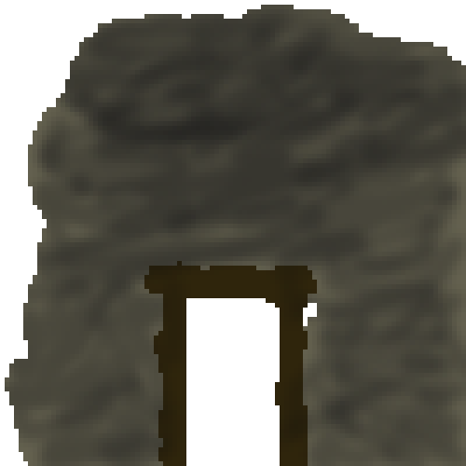
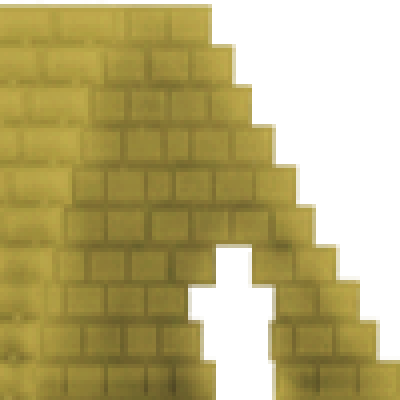
Dart: Fires repeatedly in the Ancient Egyptian level. Takes 2/5 of your full health bar.
Hub Portal: Spawns in after meeting victory requirements in a level. Teleports you back to the hub and plays a victory sound effect.
Support Boards: An aesthetic decoration meant to look like it’s holding up the wooden platforms in the Ind. Revolution level.
Wooden Platform: Exactly what the name suggests. It’s a wooden platform used in the Ind. Revolution level. The player must jump across them to reach the end.
Play Button: Starts the game when clicked (left mouse button).
Quit Button: Closes the game when clicked (left mouse button).
Ind. Revolution Entrance (cave opening): When the player walks into this, they are transported to the Ind. Revolution tutorial room.
Ancient Egypt Entrance (pyramid opening): When the player walks into this, they are transported to the Ancient Egypt tutorial room.

Slide 10





Characters
Miner-Man: This is the player’s avatar. Unknowing of the trials ahead of him, he tries to uncover the truth of mining. Through this he hopes to find his own truth.
Pharaoh Snoot: The demanding and haughty pharaoh of Ancient Egypt. He sends you on one of your quests, addressing you only as “slave” and ordering you to find 5 Malachite chunks.
Undisturbed: Also known as “He Who Has The Ironic Name” After disturbing his tomb and taking his treasure, this restless spirit tries in vain to catch you before you take the last of his precious green ore.
Little Bark: The older brother of Big Squeak. In a panicked state he begs you to find and save his brother, who you find out gets caught in a cave-in.
Big Squeak: The younger brother of Little Bark. It’s your mission to rescue him from the mine after a cave-in.

Slide 11
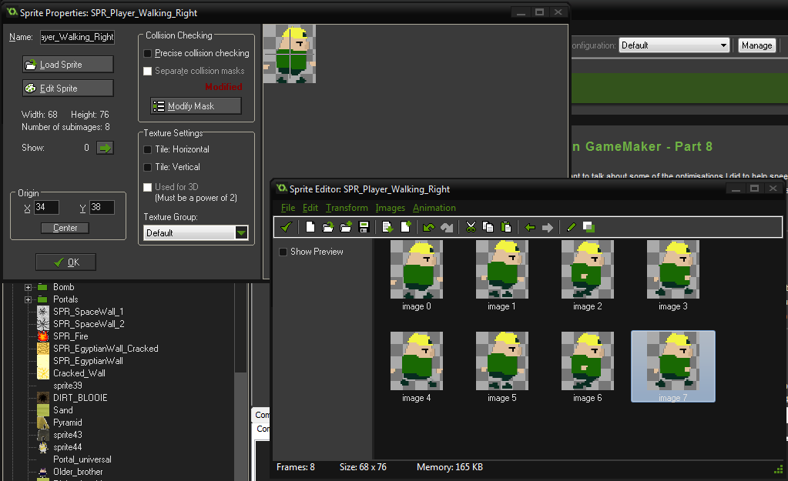
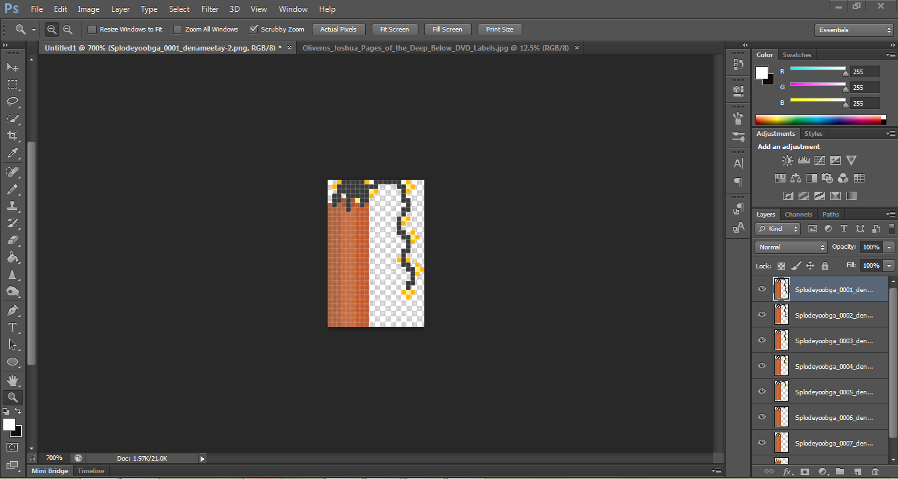
CAD/IDE
All textures, sprites and animations were created using the GameMaker IDE and Photoshop CS6.

Slide 12
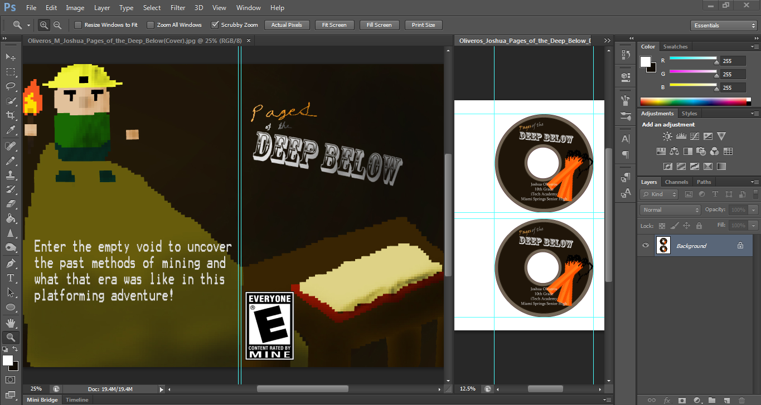
CD Case and
CD Design
Photoshop CS6 was also used to make my CD cover art and Design.

Slide 13
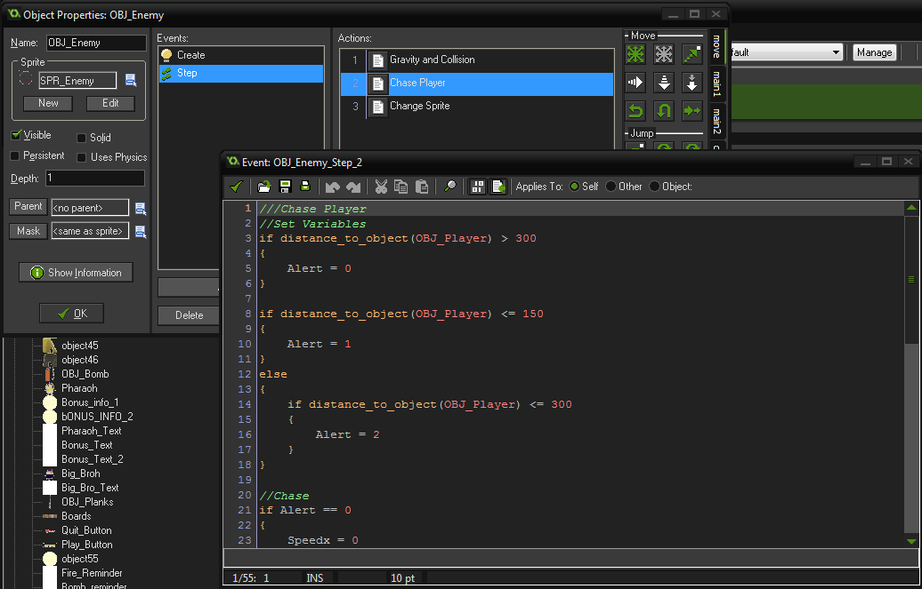
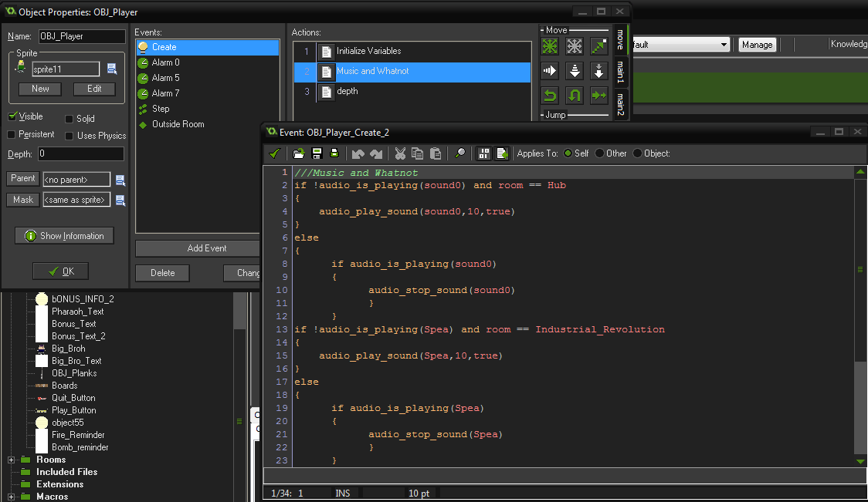
Programming
Hard coding was used for almost the entire project in GML.
Drag & Drop actions and events were only used for basic functions of the game, such as the title screen buttons and music.
The following code is an excerpt from the code used to control the collision of the “Undisturbed” with walls:
//X Axis Collision (Horizontal)
if (place_meeting(x+Speedx,y,Par_Wall))
{
while (!place_meeting(x+sign(Speedx),y,Par_Wall))
{
x += sign(Speedx);
}
Speedx = 0
}
x += Speedx;
//Y Axis Collision (Vertical)
if (place_meeting(x,y+Speedy,Par_Wall))
{
while (!place_meeting(x,y+sign(Speedy),Par_Wall))
{
y += sign(Speedy);
}
Speedy = 0
}
y += Speedy;

Slide 14
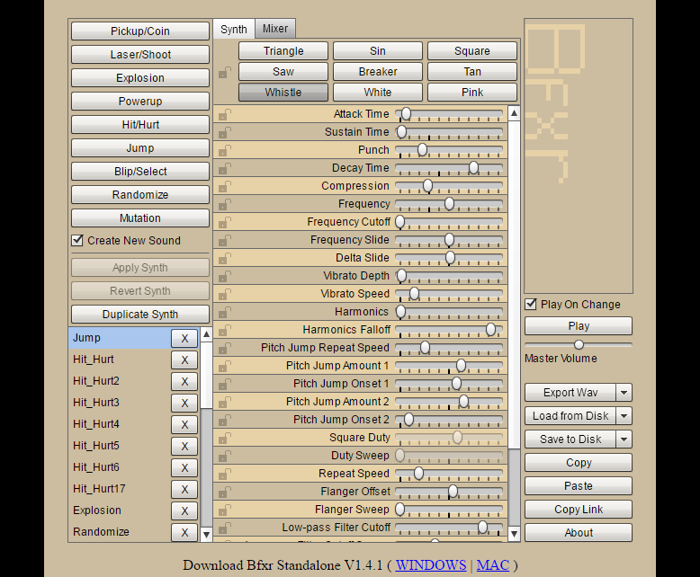
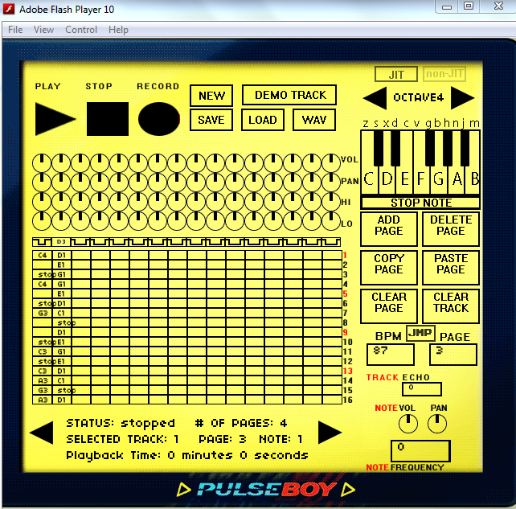
Audio
A free sound effect creating website known as www.bfxr.com was used to produce my sound effects.
The website gives the creator full control over things like pitch, harmonics, and depth of the sound they’re trying to produce. All sound effects created on the website are royalty free and the right to make sound effects is guaranteed to users of the interface..
As for music, an online 8-bit music program called Pulseboy was used to make the music for this game. Once again, it is royalty free and I maintain my right to make music on said program.

